Slide 1
“Technocology”
Technology and Ecology
Ahmad Akib 1002809
Hannah Low 1003143
Laura Ong 1002464
Vinh 1002225

Slide 2
Outline
Definition of technology
Technology’s interactions
Case study 1
Case study 2
Evaluation
Questions

Slide 3
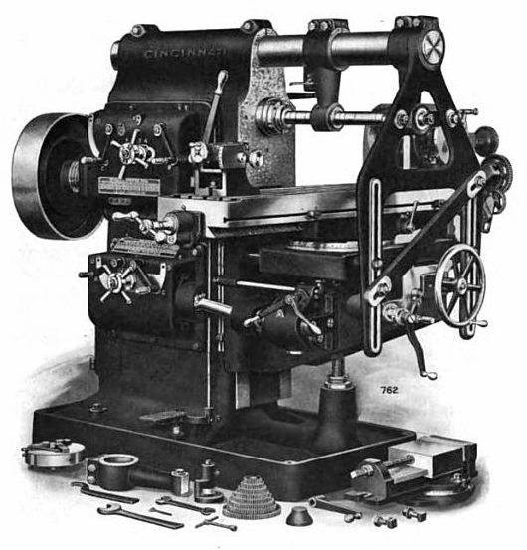

Technology
Technology is made by two greek word techne and logos.
Techne: refer to the craftsmanship. Hence, it refer to the product of our physical labour.
Logos: refer to the reasoning. Hence, it refer to the product of our mental labour.
Skilled-oriented technology
Machine/Tool technology

Slide 4
Technology interaction
Using Geertz’s ecology model:
Technology interacts with more than one element.
It affects other ecology elements beside its main target.
Exp: Green revolution did not only increase crop yield, its effect includes the disruption of farmer collaboration.

Slide 5
Ecological technology
We shall then consider technology using an ecology model:
Its impact on all environment elements.
Its impact on human activity (sociogenesis).
Exp: Farmer collaboration through temple is a critical element. The holy water temples are a ritual technology and they manage the irrigation system.

Slide 6
Case Study: Let’s build a wall!
Progression of walls to allocate peoples in separate places
Great Wall of China, Hadrian’s Wall (to keep out the barbarians, stone wall)
Berlin Wall (to keep East Berliners in; electric fence, manned posts, 5000 successful crossings)
Potential Wall between US and Mexico (sensors, cameras)
But as seen, the last two… didn’t quite work. So why do people build walls?

Slide 7
Walls as Power
Walls suggest “permanence, security, and identity”[1]. You were either in, or out.
Previously, walls between countries were porous. This led to frequent crossings. However, the nationalistic pride meant that countries were more likely to enforce their borders. Now with technology, borders can be heavily monitored, better guarded.
The wall became a symbol for Trump’s presidency, a promise that he would limit immigration. The thing is, he has been very effective at making immigration more difficult for people trying to enter legally and illegally – yet the wall project still eludes him. [2] Rather than national security, he’s more concerned about politics

Slide 8
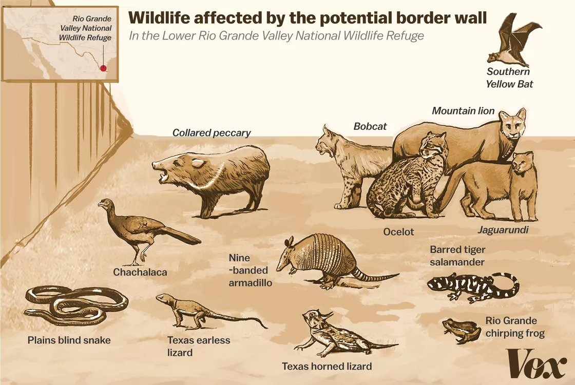
The effects of a wall on
The environment: 1. Disruption of habitats
19 protected species on the California Border
39 protected species in Arizona
Property expense
Rio Grande, Colorado River cannot be used -> Dig further into US territory
Purchase of property required -> sociological damage
Human Activity:
Generations of families that belong to neither the interior Hispanics/Latinos or the Mexicans, who live along the border and now have their lives disrupted.

Slide 9
What does this mean?
Wall being used as a statement by Trump; it need not necessarily work[3] Illegal immigrants are more likely to be overstayers from South America who come in by air.
But it’s already creating social disruption due to Trump insisting on a 5 billion dollars budget for building the wall and poor diplomatic relations with Mexico (who see it as an insult)
Similar to how there would be an arms race against pests (Balinese farmers had been into a struggle to stay one step ahead)[4], there exists a competition between border crossers, ICE* as long as desperate migrants are available.
*Immigration and Customs Enforcement
Notes:
What the wall is supposed to solve
I shall now hand over my time to Akib, who’s sharing on a similar arms race.

Slide 10
Case Study 2: Bike Sharing in Singapore
Do the names oBike, OFO, Mobike ring a bell to you?
Alternative mode of transport to places that are too far to walk but too close to drive.
Convenient and affordable to most people.
And yet, all of these companies are not operating in Singapore anymore.
Notes:
Script:
Do the words oBike, OFO, Mobike ring a bell to you? These companies introduced the bike sharing to Singapore back in 2017.
Bike sharing became an alternative mode of transport to places that are too far to walk but too close to drive. Paired with bonuses such as free rides, this technology is very convenient to many people. The last mile
And yet, all of this companies are not operating in Singapore anymore

Slide 11
Bike Sharing; The good, the bad and the ugly
Bike sharing did not introduce a new technology (transportation device) to Singapore but instead greatly scaled up the level of accessibility of bicycles to the people. There is now an affordable solution for the last mile problem.
The surrounding environment was also affected due to indiscriminate parking and dumping of these shared bikes in places such as rivers and parks.
In an immediate setting, the oversaturation of shared bicycles at housing estates became very unsightly for the residents.
Notes:
Citation machine, easybait

Slide 12
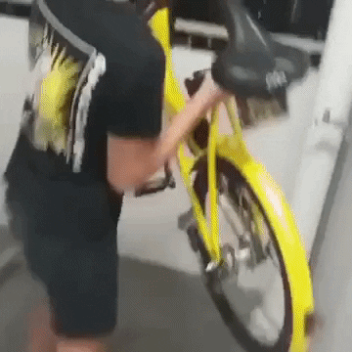
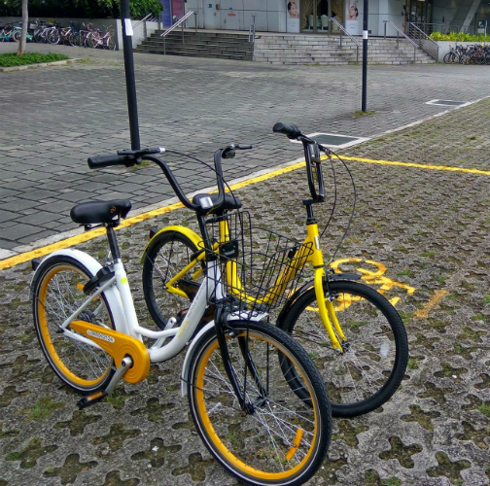
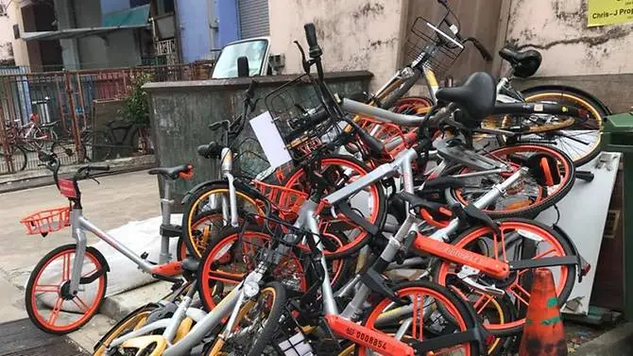
Bike Sharing; The good, the bad and the ugly
QR Code Parking Areas
Indiscriminate Parking
Delinquency
Notes:
Sources: https://www.channelnewsasia.com/news/singapore/bike-sharing-operators-authorities-move-to-cut-irresponsible-use-9282464
https://www.channelnewsasia.com/news/singapore/obike-ofo-mobike-bike-share-pledge-brakes-indiscriminate-parking-10459394
https://www.youtube.com/watch?v=oGHVJxKodbs
Taken from : https://www.lta.gov.sg/apps/news/page.aspx?c=2&id=d35fdfa6-6cfb-477d-ac12-c93aa5a6a78f

Slide 13
Maintaining a Shared technology
In response, new legislation was introduced to better control the shared bike technology by limiting its negative impacts on the environment and punishing those who abuse it.
Similar to how the farmers and temples in Bali work to produce a good harvest, the bike sharing technology can only thrive when there is a sustained and synergetic effort from both the users and operators in ensuring that the system works for everyone.
Sociogenesis - from individualistic to a collective community.
Notes:
Without proper infrastructure and enforcement of the bikes, an increasing number of users became more indiscriminate with handling the shared property. Legislation came too hard too fast and these companies choose to exit the market.

Slide 14
Evaluation
Every technological development has to consider the environmental, sociological and economic impact
Notes:
sustainability of human-environment relations: technology on the human and environment
technology in question had good intentions
green revolution --> wall to maintain national pride --> bike sharing, go green promote healthy living affordability etc
but we have seen the extending effects of these technologies on human interactions and the environment around it
(summary)
Balinese:
wall:
bike sharing:
evaluation : every technology development has to consider the environmental, sociological and economic impact

Slide 15
Questions for the Audience
Using the model Geertz proposed, how would you design a new technology holistically?
What are technologies that don't affect environment directly but affect how society behaves in it? Eg Pokemon GO!
Notes:
Strong digital sphere but weak physical interations eg facebook

Slide 16
References
[1]D'Costa, K. (2017, February 07). The (Anthropological) Truth about Walls. Retrieved April 8, 2019, from https://blogs.scientificamerican.com/anthropology-in-practice/the-anthropological-truth-about-walls/
[2]Holpuch, A. (2019, January 15). What exactly is Trump's border wall and why does he want $5.7bn for it? Retrieved from https://www.theguardian.com/us-news/2019/jan/15/trump-mexico-border-wall-status-migrants
[3]Barclay, E., & Frostenson, S. (2019, February 05). The ecological disaster that is Trump's border wall: A visual guide. Retrieved April 9, 2019, from https://www.vox.com/energy-and-environment/2017/4/10/14471304/trump-border-wall-animals
[4]Lansing, J. (1987). Balinese "Water Temples" and the Management of Irrigation. American Anthropologist, 89(2), new series, 326-341. Retrieved from http://www.jstor.org/stable/677758

Slide 17
References
[5] Bike-sharing operators, authorities move to cut irresponsible use of bicycles. (2017, October 05). Retrieved April 10, 2019, from https://www.channelnewsasia.com/news/singapore/bike-sharing-operators-authorities-move-to-cut-irresponsible-use-9282464
[6] Alvinology. (2017, June 15). Killer Litter: Singapore guy throws ofo bike down high rise building. Retrieved April 10, 2019, from https://www.youtube.com/watch?v=oGHVJxKodbs
[7] First Reading of the Parking Places (Amendment) Bill. (n.d.). Retrieved April 10, 2019, from https://www.lta.gov.sg/apps/news/page.aspx?c=2&id=d35fdfa6-6cfb-477d-ac12-c93aa5a6a78f

